Slide 1
Best Practices for Running Microsoft SQL Server on AWS
Baris Furtinalar
Microsoft Specialist Solutions Architect
AWS
Gianluca Hotz
Microsoft SQL Server MVP
UGISS

Slide 2
Agenda
Where can I run SQL Server on AWS?
Amazon RDS for SQL Server
Optimizing Performance for SQL Server on EC2
High Availability Best Practices for SQL Servers on AWS
Migrating SQL Server to EC2
Q&A

Slide 3


Where can I run my SQL Server workloads on AWS?
Amazon Relational Database Service
(Amazon RDS)
Managed service with up to 128 vCPU, 4TBRAM, and 16 TB storage
Amazon Elastic Compute Cloud
(Amazon EC2)
Self-managed virtual machine with up to 448 vCPU, 24TB RAM, and 400-TB storage

Slide 4
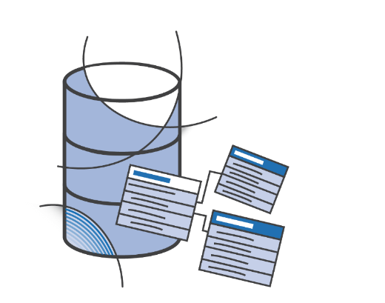
Options for Deploying SQL Server on AWS
Amazon RDS for SQL Server
SQL Server on Amazon EC2
Scaling
Scaling
Consider RDS first
Focus on business value tasks
High-level tuning asks
Schema optimization
No in-house database expertise
High Availability
Need full control over DB instance
Backups
Replication
Clustering
Options that are not available in RDS
High Availability
Database Backups
Database Backups
DBMS Patching
DBMS Patching
DBMS Install/Maintenance
DBMS Install/Maintenance
OS Patching
OS Patching
OS Install/Maintenance
OS Install/Maintenance
Power, HVAC, net
Power, HVAC, net
AWS managed
Customer managed

Slide 5


SQL Server Features at a Glance
Amazon RDS
Amazon EC2
Versions Supported:
2012 – 2019
All
Editions Supported:
Express, Web, Standard, Enterprise
All
High Availability:
AWS-managed
Self-managed; AlwaysOn, Mirroring…
Encryption:
TDE, Column-level, Always Encrypted, TLS, EBS encryption
Authentication:
Windows & SQL Authentication
BI Stack:
SSIS, SSRS, SSAS (tabular)
All
Backups:
AWS- managed
Self-managed
Maintenance:
AWS- managed
Self-managed

Slide 6
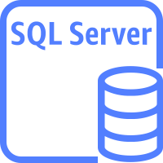
Amazon RDS with SQL Server

Slide 7
Amazon RDS: Hassle-free flexibility
Instance type selection:
t3 instances for lower cost
m5/m5d instances
r5/z1d/x1e instances for more RAM
EBS volume type selection:
GP2 volumes for lower cost
IO1 volumes for I/O intensive, critical workloads

Slide 8
Compute and Storage Scaling
Scale Compute to
Handle Increased Load
Up to 128 vCPUs
4TiB of RAM
Scale Storage for
Larger Data Sets
Scalable EBS storage up to 16TiB
Scale Down to
Control Costs
As little as 4 vCPU and
16 GiB of RAM

Slide 9



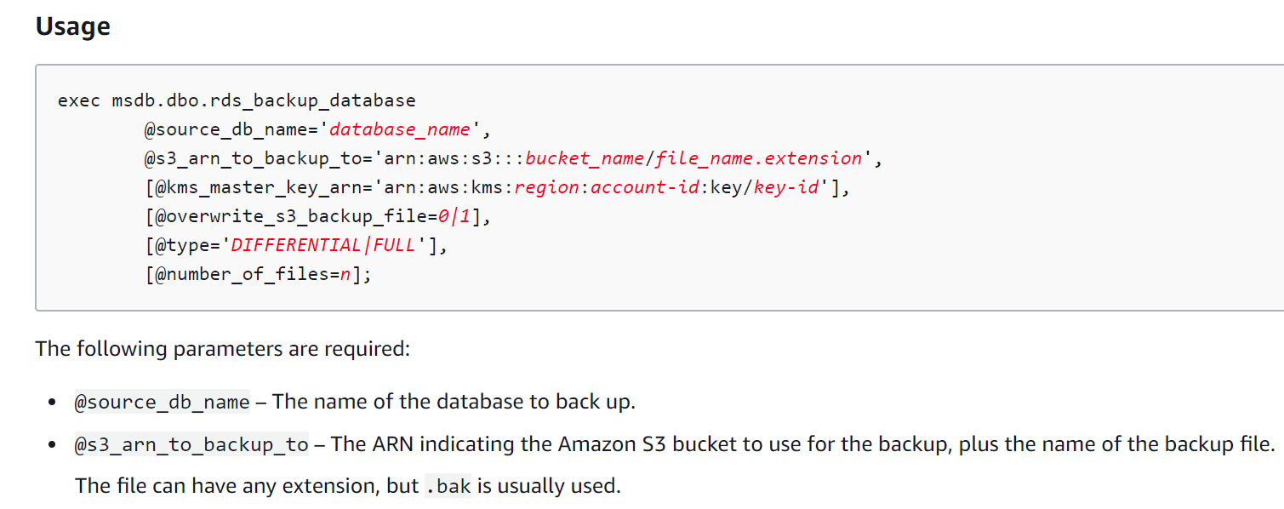

Automated backups, Snapshots and Native Backups
Backup and restore directly to and from S3 bucket
Supports Compression
Only full & diff backups (no t-log)
Full, diff & t-log restores
Multi-file backup/restore
Amazon RDS SQL Server
*.bak
IAM
Amazon S3
SQL Server

Slide 10



Amazon RDS Multi-AZ SQL Server
Region A
Always On AG (Basic AG for Standard) for 2016, 2017 & 2019
DB Mirroring for 2012 and 2014
Synchronous Secondary hot stand-by
Automatic & Manual Failover
No read traffic
VPC
Availability Zone 1
Availability Zone 2
Private subnet
Private subnet
Synchronous commit
Automatic failover
Amazon RDS
primary
Amazon RDS
secondary

Slide 11
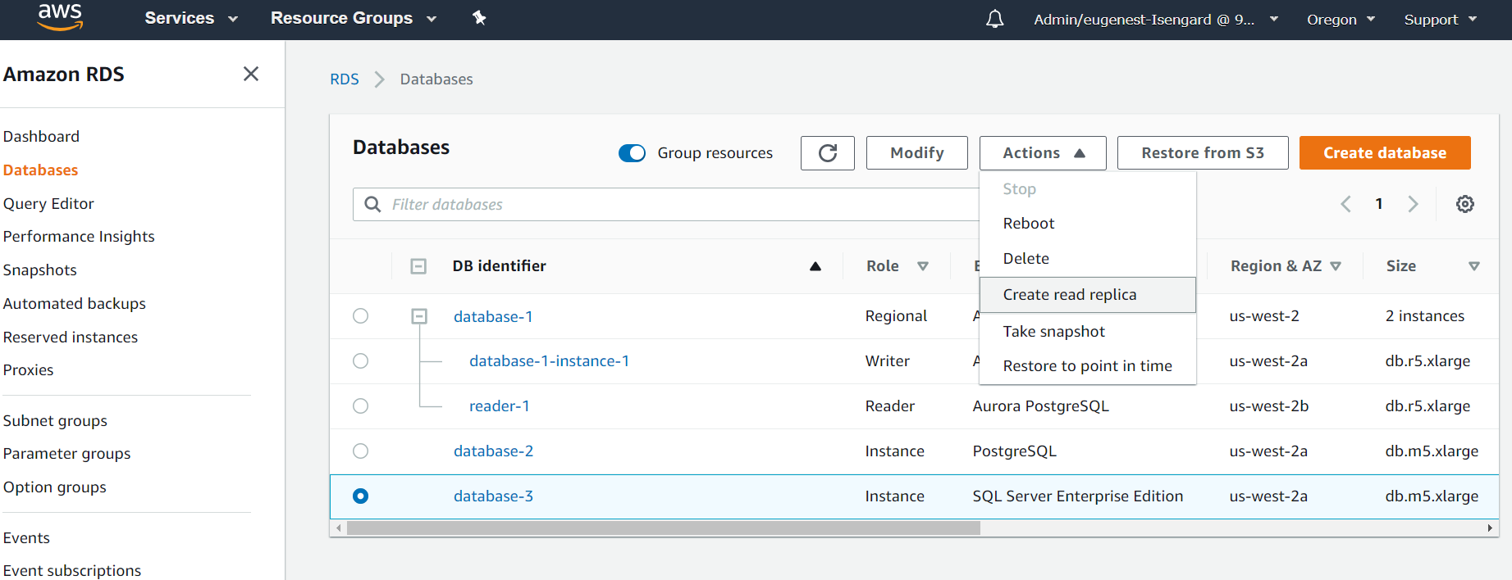
Read scale-out with Amazon RDS
2016+ Enterprise Edition feature
Up to 5 asynchronous read replicas
In-region
Promotion
Separate end-point

Slide 12
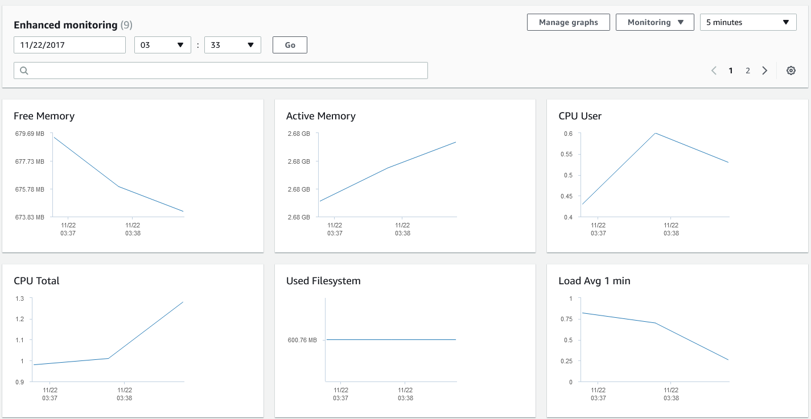
Amazon RDS Enhanced Monitoring
Overview:
OS Level Monitoring Metrics – 26 system and per process metrics
Metrics delivered to CloudWatch Logs
Up to 1 second granularity
Compared to CloudWatch Metrics:
Agent based metrics collections
There can be differences with CloudWatch metrics due to collection source (hypervisor vs. agent) – eg. CPU

Slide 13
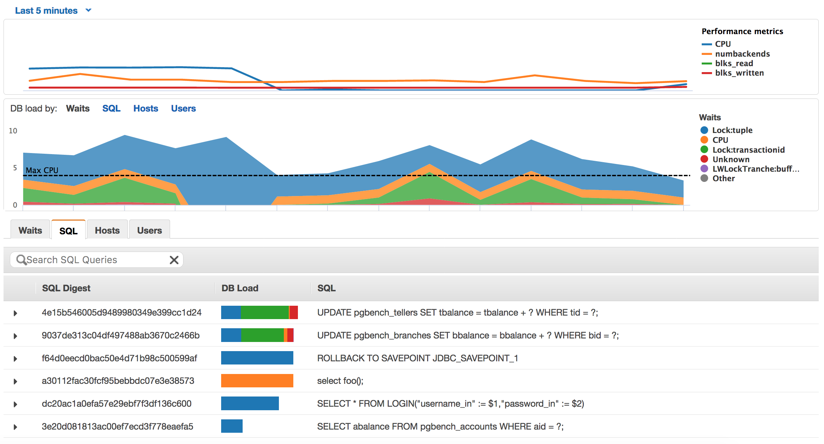
Performance Insights for RDS SQL Server

Slide 14

SQL Server on Amazon EC2
SQL Server

Slide 15
SQL Server on Amazon EC2
SQL Server
How to start
Spin up an EC2 instance and install from customer media (BYOL)
Spin up an EC2 instance that includes SQL in the Amazon Machine Instance (AMI)
Self-Managed SQL Server
Security, patching & updates
Backups
High Availability
Full SQL Server sysadmin privileges

Slide 16
Optimizing Performance for SQL Server on EC2

Slide 17
Amazon EC2: Purpose-built computing
Current instance families and generation | Family/usage
M5, M5a, M5zn | General purpose compute
T2, T3 | Burstable performance
C5, C5n, C5a,C4 | Compute optimized
X1, X1E, R5, R5d, R5a, Z1d | Memory optimized
P2, G3, F1 | Accelerated computing
I3, I3en | Storage optimized (I/O)
H1, D2 | Storage optimized (Density)
(4.5GHz)
(4.0GHz)

Slide 18


Get the maximum EBS performance on Amazon EC2
General Purpose SSD
Amazon EC2
Durability
99.8% - 99.9%
Size (Min-Max)
1 GiB - 16 TiB
GP3
GP3
Max IOPS
per volume
(16 KiB I/O)
R5b.4xlarge
16,000
Max EBS Bandwidth 10,000Mbps
16,000
16,000
Maximum IOPS 43,333
Max throughput
per volume
1,000 MiB/s
Total IOPS=32,000

Slide 19
Get the maximum EBS performance on Amazon EC2
Provisioned IOPS SSD
Amazon EC2
Durability
99.999 %
Size (Min-Max)
4 GiB - 16 TiB
IO2
IO2
Max IOPS
per volume
(16 KiB I/O)
R5b.12xlarge
64,000
Max EBS Bandwidth 30,000Mbps
64,000
64,000
Maximum IOPS 130,000
Max throughput
per volume
1,000 MiB/s
Total IOPS=128,000

Slide 20
Amazon EBS io2 Block Express Volumes
256.000 IOPS per volume
4000 MB/s throughput per vikume
64 TiB per volume
99.999% durability
Available with Amazon EC2 R5b instances
Supports standard io2 features
IO2 Block Express
IO2 Block Express

Slide 21


Place tempdb in EC2 Instance Store
Amazon EC2
What is instance storage?
Some instance types come with direct attached disk-based storage
SSD
NVMe SSD
Included in the hourly cost
Data on instance storage does not persist a user- initiated instance stop/start or hardware failure
Fast disk I/O without going over the network
Traffic does not count towards EBS IOPS
z1d.12xlarge
2 x 900 NVMe SSD

Slide 22

Place tempdb in EC2 Instance Store
Amazon EC2
What is instance storage?
Some instance types come with direct attached disk-based storage
SSD
NVMe SSD
Included in the hourly cost
Data on instance storage does not persist a user- initiated instance stop/start or hardware failure
Fast disk I/O without going over the network
Traffic does not count towards EBS IOPS
z1d.12xlarge
Disk Mirroring
2 x 900 NVMe SSD
tempdb data files
tempdb log files

Slide 23




Amazon FSx for Windows File Server
Amazon FSx for Windows File Server
Region
CREATE DATABASE [DBonFSx] ON PRIMARY ( name = N’DBonFSx_data’,
filename = N’\\fs-0123456789.example.com\DB\DBonFSx_data.mdf’,
size = 8192kb, maxsize = unlimited,filegrowth = 1024kb )
log ON ( name = N'DBonFSx_log’,
filename =N‘\\fs-0123456789.example.com\DB\DBonFSx_log.ldf’,
size = 1024kb, maxsize = 2048gb, filegrowth = 10%)
GO
Amazon FSx for Windows File Server
\\fs-0123456789.example.com
SQL DB instance
mdf
ndf
ldf

Slide 24
Optimize your disk layout or file distribution
Data Files
.mdf
.ndf
.ndf
Random Access
Log Files
Sequential Access
.ldf
.ldf
.ldf
Tempdb Data Files
.mdf
.ndf
.ndf
Random Access
Sequential Access
Tempdb Log Files
.ldf
.ldf
.ldf
Backup Files
Sequential Access
.bak

Slide 25


Optimize your disk layout or file distribution
Amazon EBS
File distribution
Amazon EC2 Instance
GP3/IO2
Database File Group
mdf
SQL Data Files
GP3/IO2
SQL Server
ndf
GP3/IO2
Tran. Log Files
ldf
Instance Store Volumes
TempDB Data/Log Files
mdf
ndf
ldf
ST1/SC1
Backup Files
bak/trn

Slide 26
High Availability Best Practices for SQL Server on EC2

Slide 27
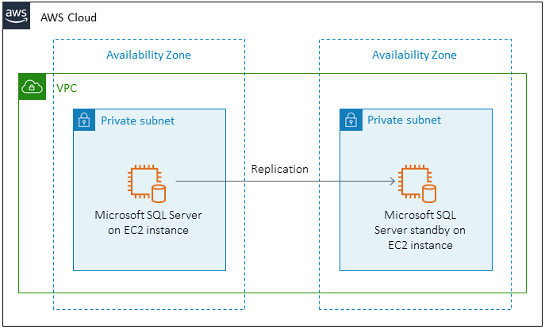


SQL Server HA/DR on EC2
Windows clusters can span Availability Zones or regions
Mirroring
AlwaysOn Availability Groups
Transaction Log Shipping
SQL Failover Cluster Instance

Slide 28




Multi-AZ Always On Availability Group
Infrastructure:
Shared-nothing configuration
Storage configured and managed outside of WSFC
Flexibility and granularity of storage configuration and maintenance
Limited SQL resources managed by WSFC
AWS Cloud
VPC
Availability Zone A
Availability Zone B
Availability Zone C
Private subnet
Private subnet
Private subnet
File Share Witness
Always On AG
1st SQL Replica
Sync Mode Auto Failover
2nd SQL Replica
10.0.10.0/24
10.0.20.0/24
10.0.30.0/24
SQL Server:
Database-level HA solution
Manual adding logins, SQL Agent jobs, certificates and other SQL Server instance level objects to all secondary
Data/Transactions replicated through SQL Server
Private subnet
Private subnet
Active Directory DC1
Active Directory DC2
10.0.40.0/24
10.0.50.0/24

Slide 29
Multi-AZ Always On Availability Group
AWS Cloud
Best Practices:
Multi AZ setup
Use File Share Witness
MultiSubnetFailover = Yes
Connect to Listener
RegisterAllProvidersIP = Yes
Change default HostRecordTTL
SQL Native Client Providers
VPC
Availability Zone A
Availability Zone B
Availability Zone C
Private subnet
Private subnet
Private subnet
File Share Witness
Always On AG
1st SQL Replica
Sync Mode Auto Failover
2nd SQL Replica
10.0.10.0/24
10.0.20.0/24
10.0.30.0/24
Private subnet
Private subnet
Active Directory DC1
Active Directory DC2
10.0.40.0/24
10.0.50.0/24

Slide 30


Multi-Region Always On Availability Group
AWS Cloud
AWS Cloud
VPC
VPC
Availability Zone A
Availability Zone B
Availability Zone C
Availability Zone A
Private subnet
Private subnet
Private subnet
Private subnet
File Share Witness
Always On AG
1st SQL Replica
Sync Mode Auto Failover
2nd SQL Replica
Async Mode Manual Failover
3rd SQL Replica
10.0.10.0/24
10.0.20.0/24
10.0.30.0/24
10.1.10.0/24
Private subnet
Private subnet
Private subnet
AWS Transit Gateway
Active Directory DC1
Active Directory DC2
Active Directory DC3
Peering connection
10.0.40.0/24
10.0.50.0/24
10.1.20.0/24

Slide 31
SQL FCI with Amazon FSx for Windows File Server
AWS Cloud
Infrastructure:
Clustered disk resource via SMB and continuously available shares (CAFS)
AWS managed SMB file system
Storage and Network traffic using the same network pipe
Managed storage configuration and maintenance
Very limited control over file system configuration (e.g. 4k vs. 64k allocation unit)
VPC
Availability Zone A
Availability Zone B
Private subnet
Private subnet
1st SQL Node
2nd SQL Node
Shared Storage
Amazon FSx
Amazon FSx
SQL Server:
Instance-level HA solution
Logins, SQL Agent jobs, certificates and other SQL Server instance level objects are in-tact after failover
10.0.10.0/24
10.0.20.0/24
Private subnet
Private subnet
Active Directory DC1
Active Directory DC2
10.0.30.0/24
10.0.40.0/24

Slide 32

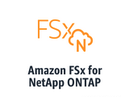
SQL FCI with Amazon FSx for NetApp ONTAP
AWS Cloud
VPC
Availability Zone A
Availability Zone B
Amazon FSx for NetApp ONTAP includes all of
ONTAP’s storage efficiency and cost-savings features
High-performance SSD storage
NetApp ONTAP offers multiple throughput capacity
Private subnet
Private subnet
1st SQL Node
2nd SQL Node
iSCSI/SMB
iSCSI/SMB
Primary
Standby
10.0.10.0/24
10.0.20.0/24

Slide 33
Migrating SQL Server to AWS

Slide 34
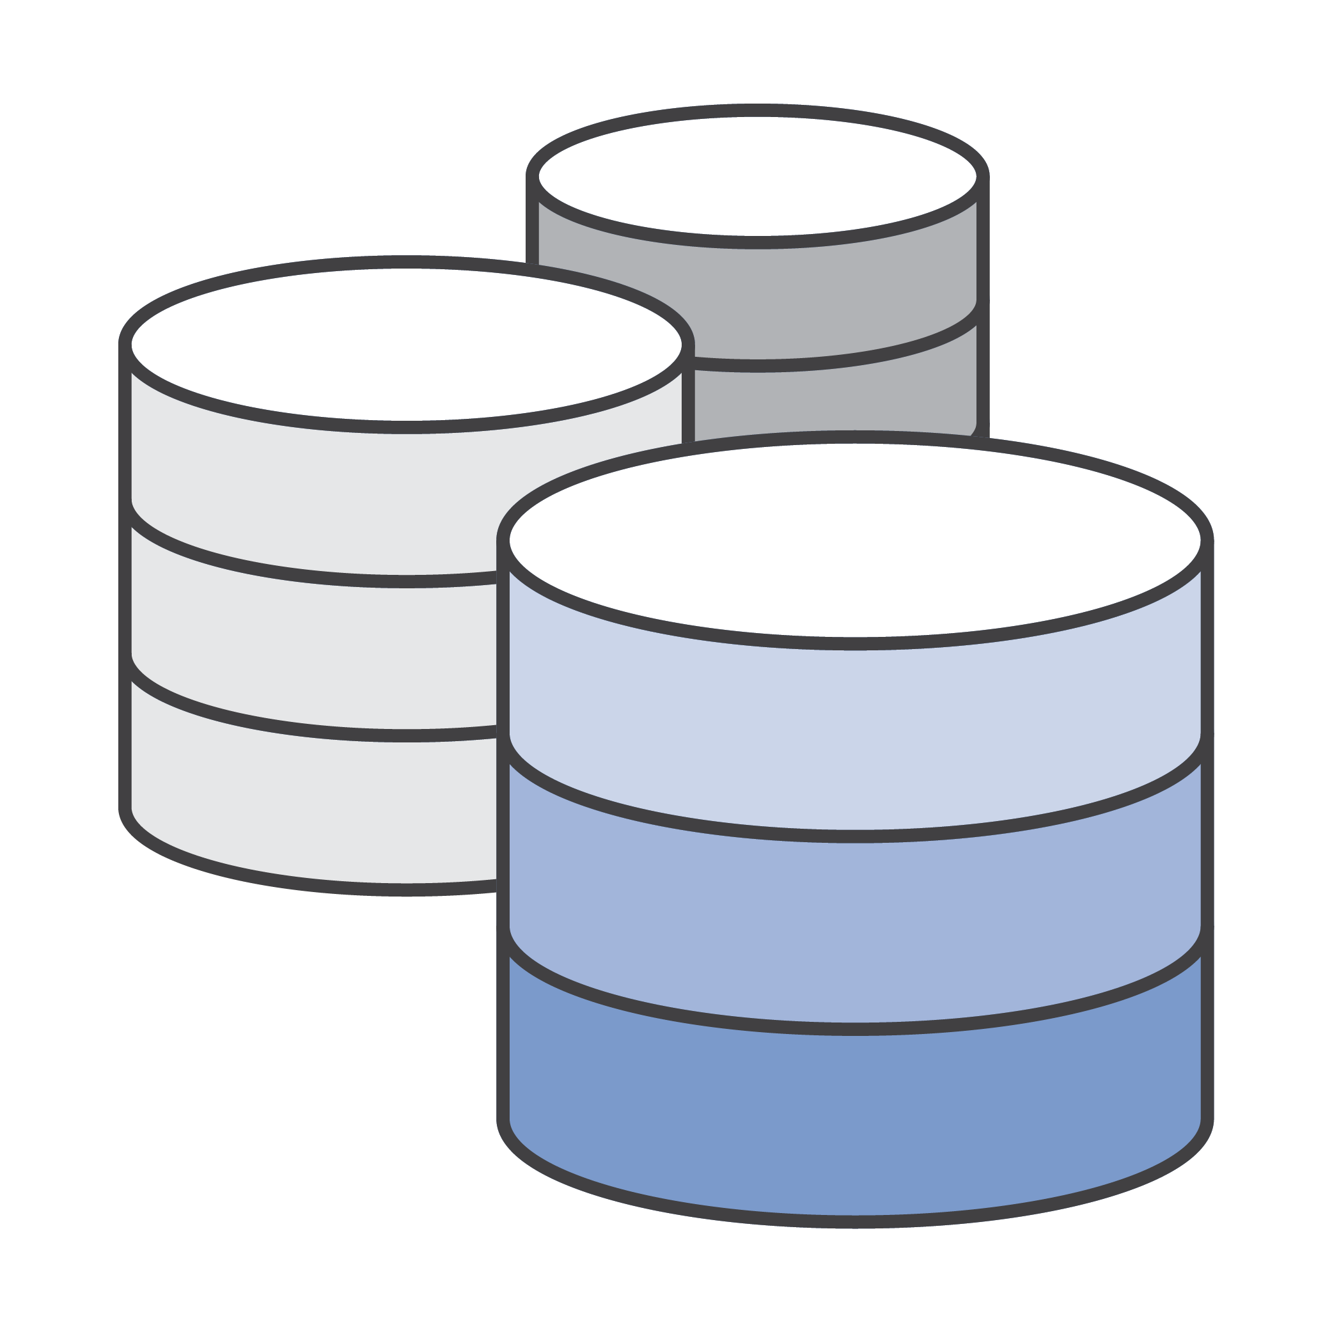

1
Backup & Restore
SQL Server’s native backup functionality
SQL Always On Availability Group
Asynchronous-commit mode, distributed AGs (SQL Server 2016+)
2
AWS Database Migration Service
Minimize downtime during migrations, migrate between different DB platforms
3

Slide 35
Thank you
migrations@amazon.com

